Slide 1

Java With IntelliJ
Conditional
Statement Part III
Switch/Case Statement

Slide 2
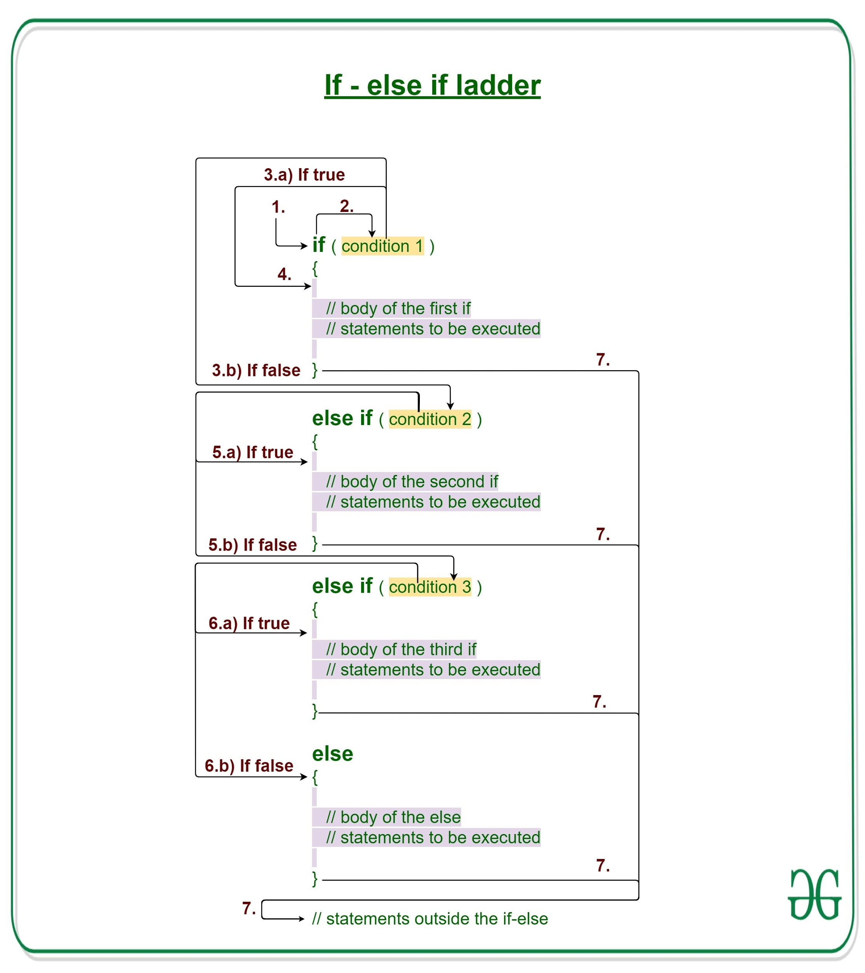
We learned that…
Conditional statement is a statement that happens as a result of something that happened
You implement if else statement by
If(//condition that you want to control)
Else //if the statement is false
You can also have more than one condition with else if statement by
else if (//what other condition if the if statement is false)

Slide 3

Switch Case
What if you want to have a multiple condition with the same variable but are sick and tired of else if statement
That’s where the switch case statement comes into play
Switch case is equivalent to [else] if (var == value/var)

Slide 4
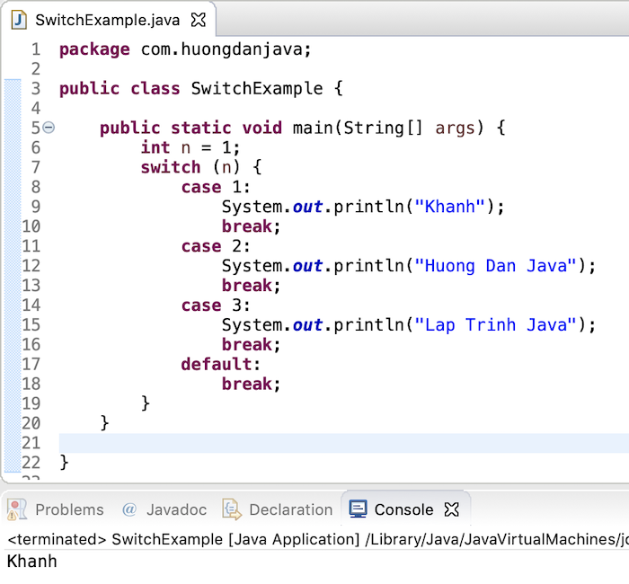
How To Implement The Switch Case Statement
Put in switch keyword followed by two curly braces
In between the two curly braces you put in case [value]:
you must put break at the end of each condition
You may put in default
default is equivalent to else statement.
if you want to use default, you have to put it at the end of all the cases or it does not work
must put in break at the end

